Slide 1
Stream Editor Software Under Guidance of : Debashree
Presented by:
Lalitha oleti – 46280169
Janavi Padala – 46281058
Singupuram Venkata Sai Sirisha – 46282019
Sai Usha Marni - 46281059
Sharanya Karedla - 46281060

Slide 2
Project id : Group-8
Tested by : Group-8
Platform/browser : ubuntu
Type of testing : Manual testing

Slide 3

TOOLS AND CONTRIBUTION
Tools :-
Ubuntu Linux as platform.
C language.
Makefile is use for compilation.
Valgrind to find memory leaks.
Splint is used for static analysis.
GCC is an optimizing compiler
Lalitha Oleti -edit design doc+coding
Janavi Padala - Design docum+coding
Sai Usha Marni - UT_IT Plan + Coding
Sharanya Karedla - UT_IT Plan + Coding
Singupuram Venkata Sai Sirisha - PPT+ Coding

Slide 4
Stream editor software:
SED is a text stream editor used on Unix systems to edit files quickly and efficiently.
The tool searches through, replaces, adds, and deletes lines in a text file without opening the file in a text editor.
This miniproject is also work like a SED.It takes input files as input and manipulated by the user.

Slide 5
Makefile:
Make is typically used to build executable programs and libraries from source code.
Make is applicable to any process that involves executing arbitrary commands to transform a source file to a target result.
It makes codes more concise and clear to read and debug.
No need to compile entire program every time whenever you make a change to a functionality or a class.
Makefile will automatically compile only those files where change has occurred.

Slide 6
Requirement Description:
SES Accepts input file and pattern_specs file.
SES shall search replace all “search” strings with corresponding “replace” strings (reading the pairs from pattern_specs file).
Pattern_specs file should support mentioning whether the search/replace is case sensitive or insensitive.
SES shall load the file contents into memory , and then do all processing in memory. Final result in written to output file at once.

Slide 7
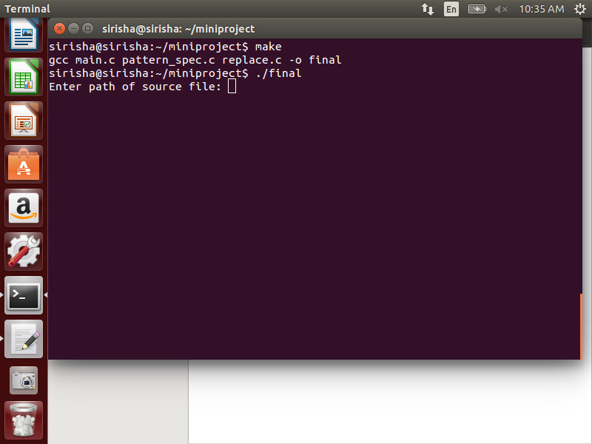
Pattern _spec.c file :
Enter the path source file.

Slide 8
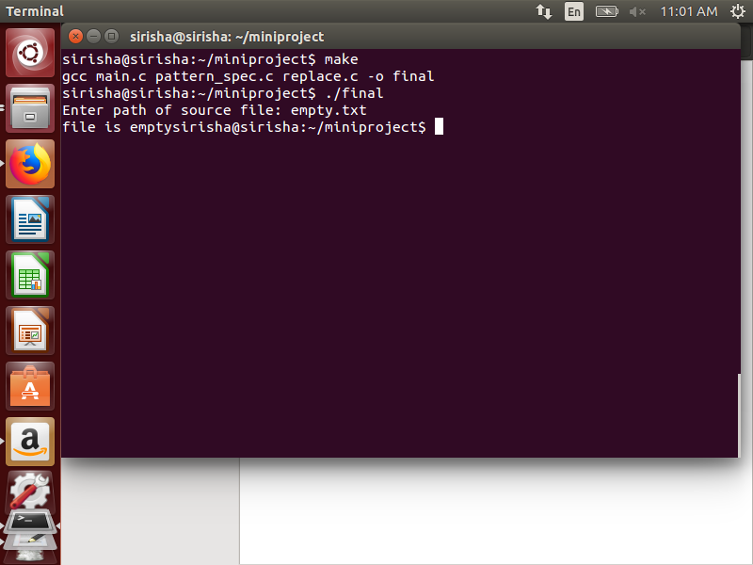
Print empty file

Slide 9

enter a existing word to be searched

Slide 10
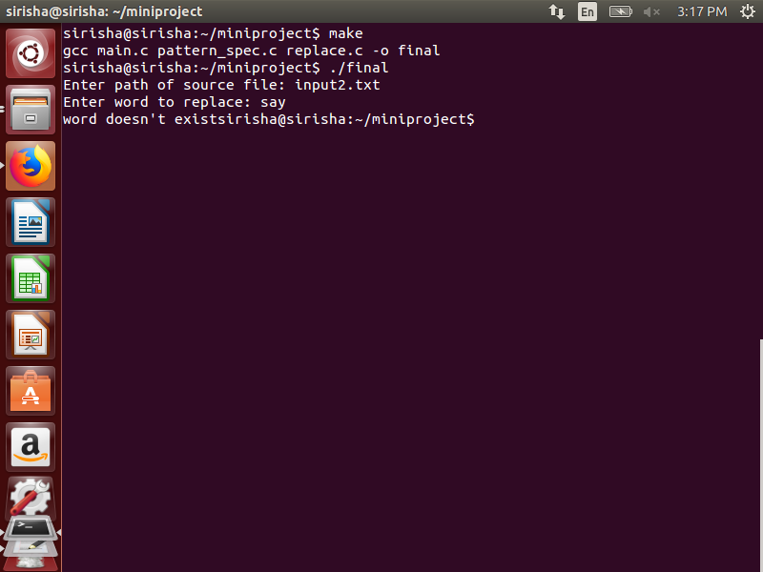
Non existing word to be searched

Slide 11
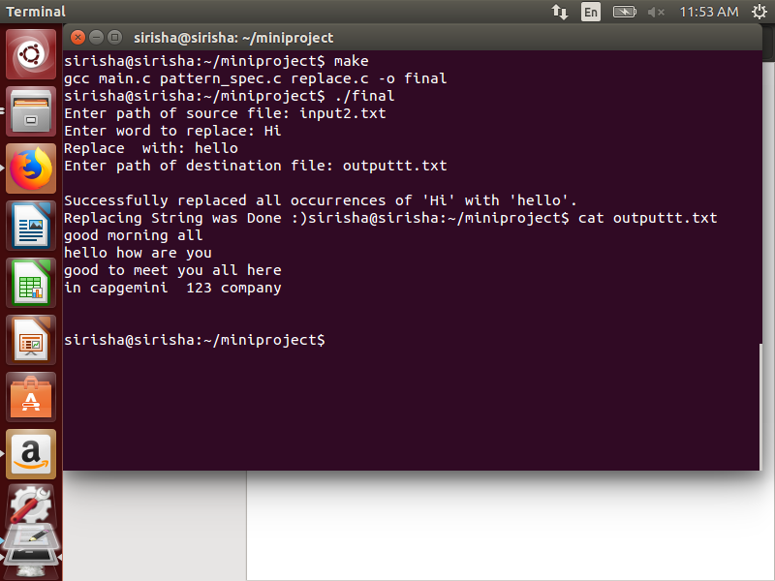
Enter word to be replaced with searched word

Slide 12
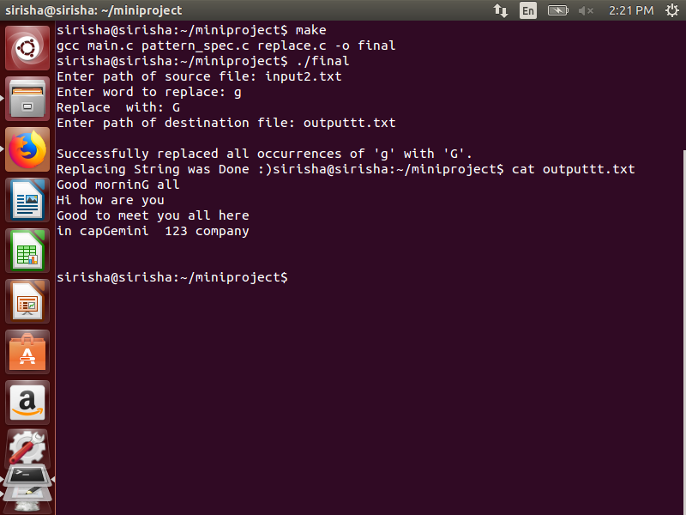
Pattern_specs file should support mentioning whether the search/replace is case sensitive or insensitive.

Slide 13
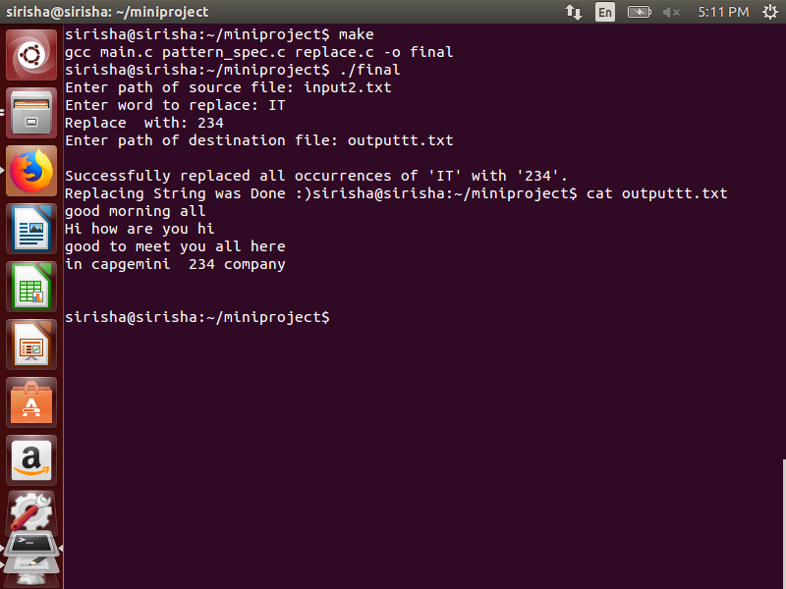
Print existing word to be replaced with numbers.

Slide 14
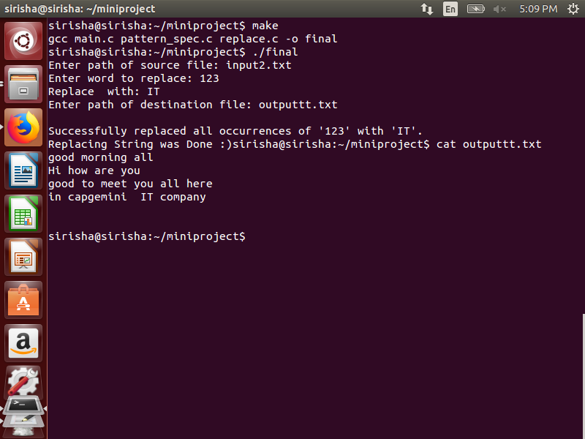
Number replaced with word

Slide 15
Output File:

Slide 16
Thank you

